Slide 1
Introduction: Deep Learning
Applications of ML to PLSCI
PLSCI 7202
Cornell University

Slide 2
Today’s lecture overview
What is a neural network?
Simple neural network architectures
Multilayer Perceptrons, CNNs, RNNs

Slide 3

Neural Networks

Slide 4

What are neural networks exactly?
Layer 2: Hidden Layer
Layer 3: Hidden Layer
Layer 1: Input Layer
Layer 4: Output
layer
Output
Input
3
There can be 100s of layers, hence “deep learning”
Edges with Weights
Neurons

Slide 5
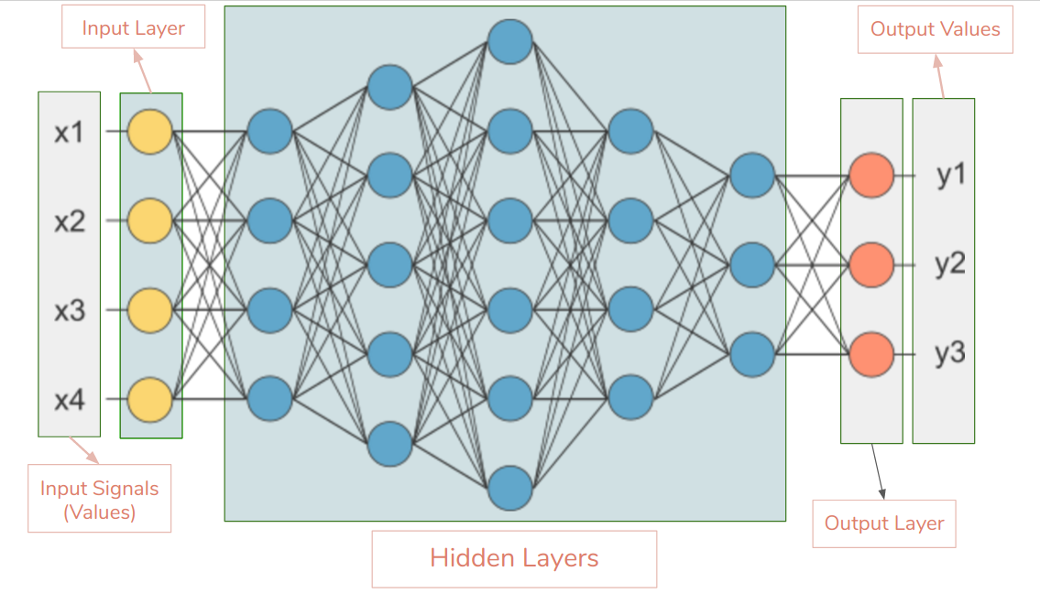
A better graphic
https://medium.com/ravenprotocol/everything-you-need-to-know-about-neural-networks-6fcc7a15cb4

Slide 6
Concept of a neuron
x₁
Add bias
Use a function
Transform
y
Transform
x₂
Add bias
GC content
Use a function
Transform
P(Gene, Protein Coding | GC content, Conservation)
Transform
Conservation
Add bias
Quarterly profits
Use a function
Transform
Stock price
Transform
General stock market trend

Slide 7
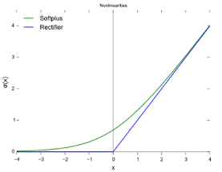
What happens in the neurons?
Activation of the node
Bias value (1)
Bias value (1)
2
2
0.12
0.12
Activation function y=max(0,x)
3.04
2*0.12 + 6*0.3
3.04
2*0.12 + 6*0.3
0.3
0.3
6
Activation of the node
6
Weights
Activation of the node
The primary goal of NNs is to find the right combinations of weights, biases, activation functions and neuron layers to get the right results

Slide 8
What do biases do?
2
-1
Activation function y=max(0,x)
Neuron will not “fire” i.e. send output to next layer
6
Bias value (1.5)
Bias value (1.5)
2
2
Activation function y=max(0,x)
0.5
0.5
6
6

Slide 9
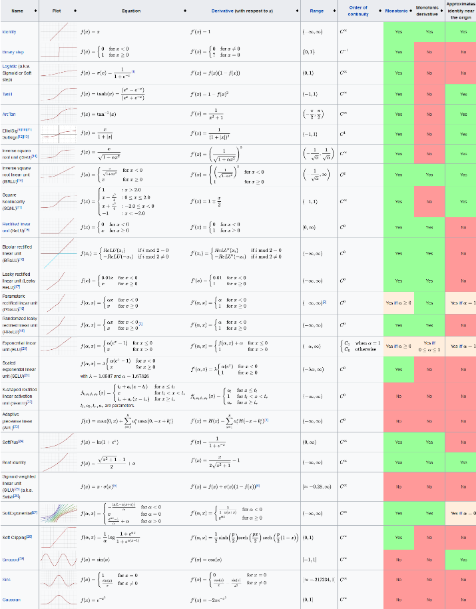

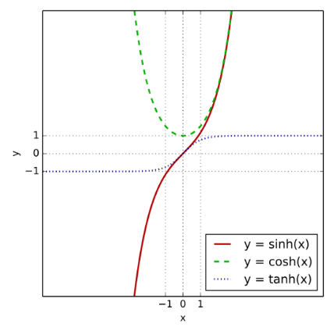
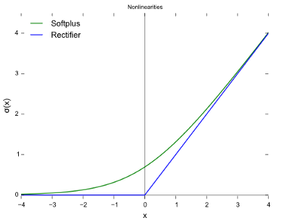
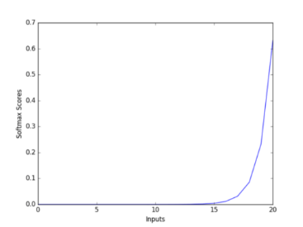
Activation functions
Sigmoidal/logistic
tanH
ReL (and its many variants)
SoftMax (mostly final layer)
https://himanshuxd.medium.com/activation-functions-sigmoid-relu-leaky-relu-and-softmax-basics-for-neural-networks-and-deep-8d9c70eed91e

Slide 10
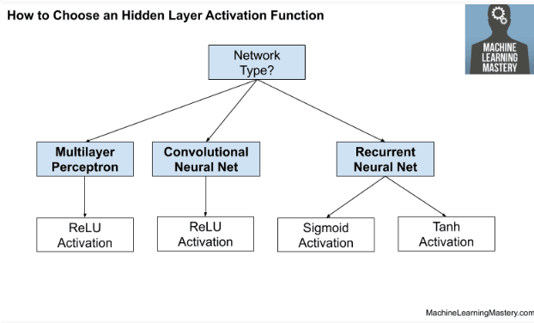
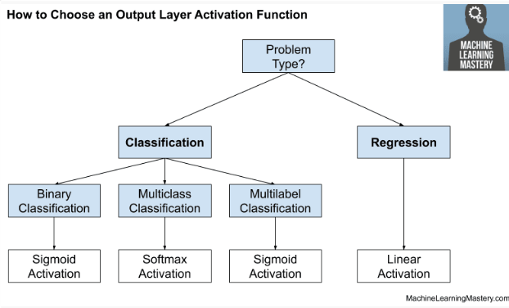
How to choose an activation function?
Rectified Linear
Sigmoidal/logistic
Sensitive to changes around 0
Saturates really fast for high or low values of x

Slide 11
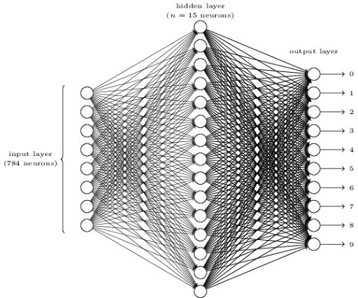
Backpropagation
Start with a Feed-forward network
3
Probabilities
8
0.2
0.2
0.3
0.5
Calculate loss function
0.2
0.2
0.4
0.1
0.8
0.2
Backpropagation to modify weights and biases
and minimize loss function

Slide 12
What is Backpropagation?
Calculate loss function for each predicted output
Adjust weights and bias of the layer prior to the output layer
Neurons that correctly predict output get more weight and vice-versa
Use Stochastic Gradient Descent to optimize parameters, so you don’t have to do optimization using whole dataset
Adjust weights and bias of the layer prior to the penultimate layer
Neurons that correctly predict output get more weight and vice-versa
Adjust weights and bias of the layer next to the input layer
For thousands of examples, would take huge amount of time
Sum up all changes for every neuron for every instance

Slide 13
How to initialize a neural network
Initialize weights –> e.g. He Weight initialization
Initialize biases –> Small random values (e.g. 0.1)
Set Activation Function –> ReLU or Sigmoid
Scale input data (optional) –> e.g. Normalization from 0-1
Let Backpropagation optimize values

Slide 14
Perceptron – the simplest feed forward network
Activation of the node
Bias value (1)
2
0.12
Activation function y=max(0,x)
Output
2*0.12 + 6*0.3
3.04
0.3
6
Activation of the node
Weights
Activation of the node

Slide 15
But…
Applications limited to classifying groups that are linearly classifiable!
Simple perceptron not good enough
Enter Multilayer Perceptrons!

Slide 16
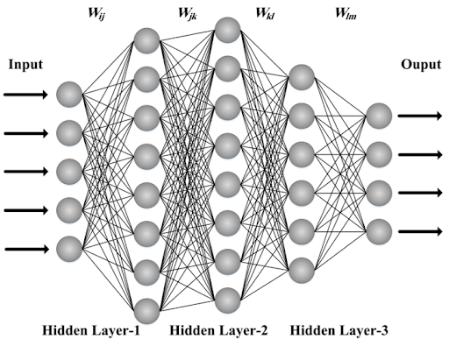
Multi-layer Perceptron

Slide 17

Convolutional Neural Nets
https://towardsdatascience.com/a-comprehensive-guide-to-convolutional-neural-networks-the-eli5-way-3bd2b1164a53

Slide 18
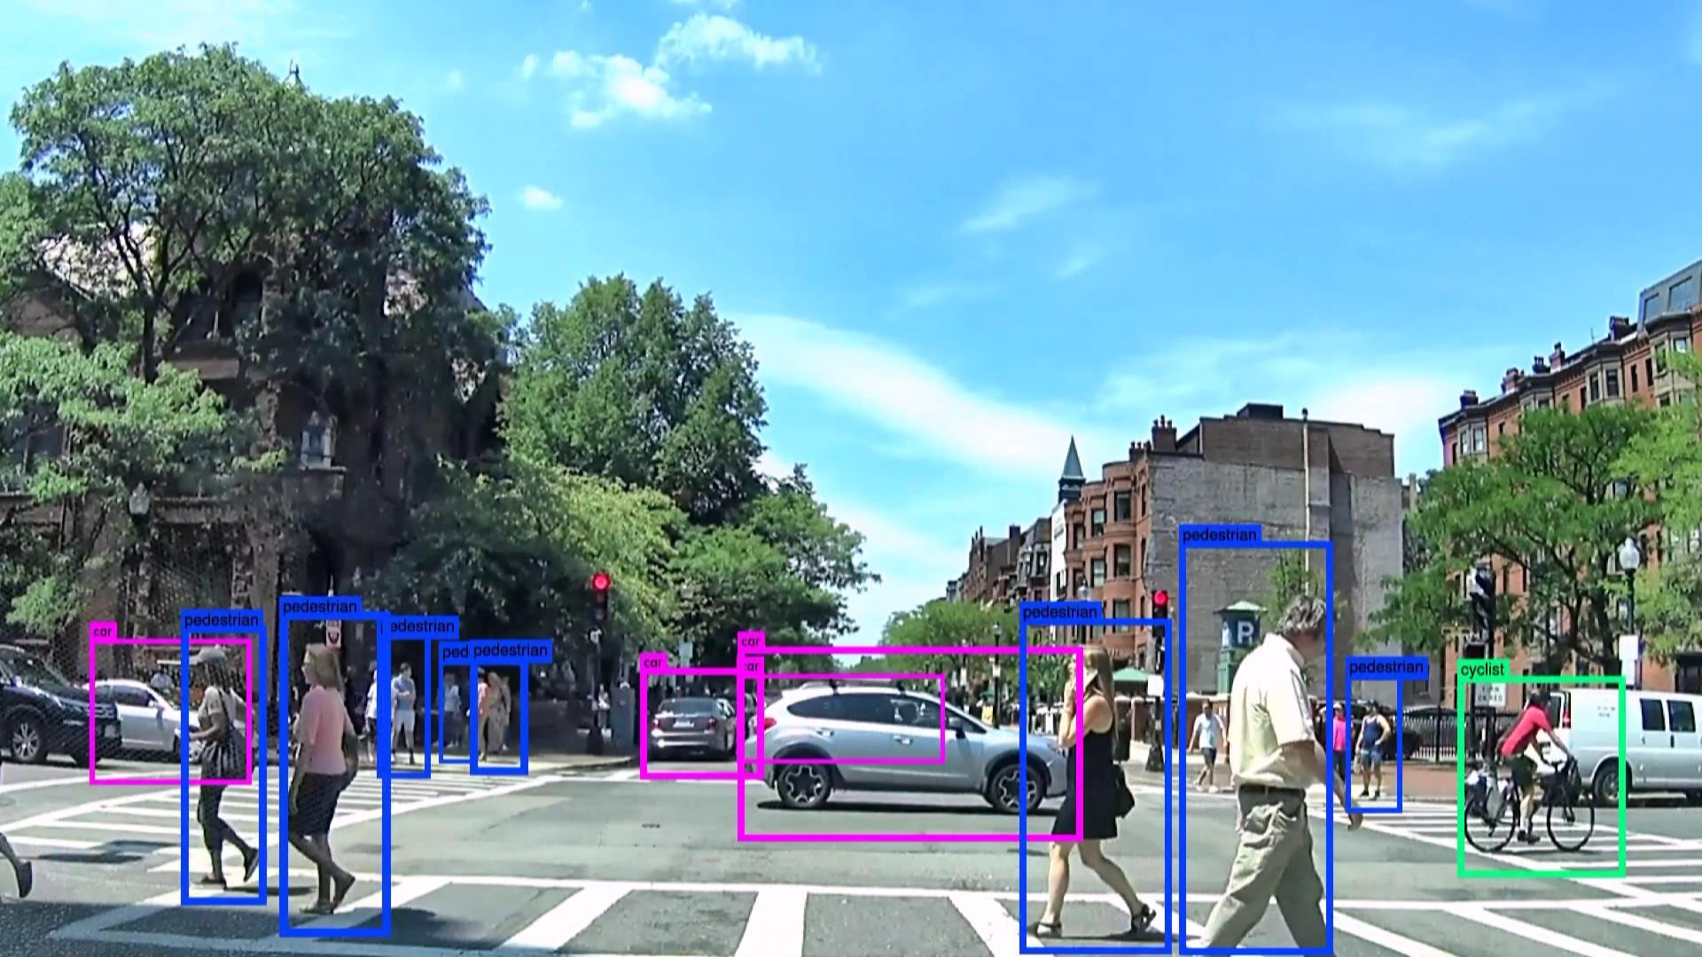
CNNs used primarily for image recognition

Slide 19
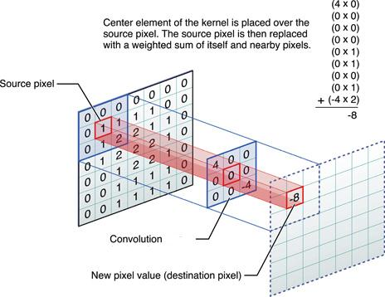
What does convolution mean

Slide 20
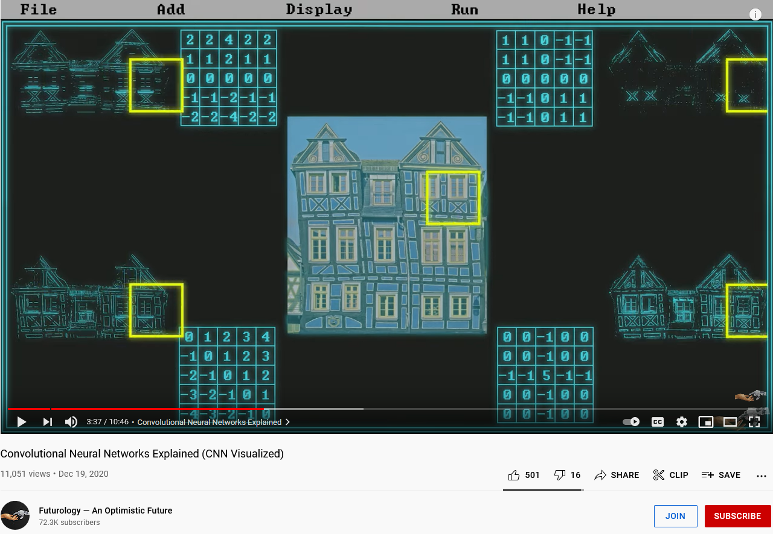
An example of how CNN and filters work
https://www.youtube.com/watch?v=pj9-rr1wDhM

Slide 21
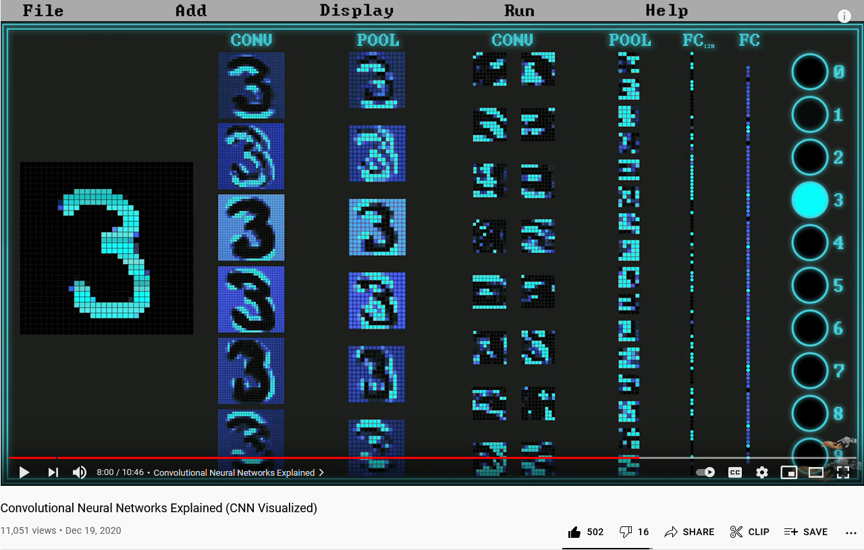
An example of how CNN and filters work
https://www.youtube.com/watch?v=pj9-rr1wDhM

Slide 22
What are the possible applications of CNNs? (student responses)

Slide 23


Recurrent Neural Networks
Sequence of features is important. RNNs learn on the memory of the previous state.
I am teaching machine learning
Machine learning teaching am I
RNN-based NNs:
Long Short Term Memory (LSTM)
Gated Recurrent Units (GRU)

Slide 24
What can RNNs be used for? (student responses)

Slide 25
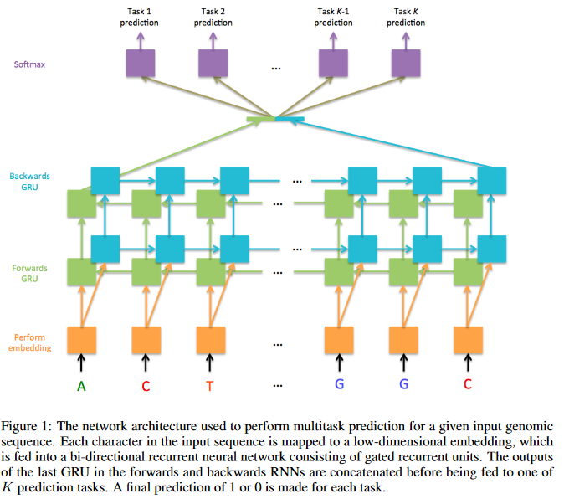
Example: RNN used for predicting gene structure
https://cs224d.stanford.edu/reports/jessesz.pdf

Slide 26
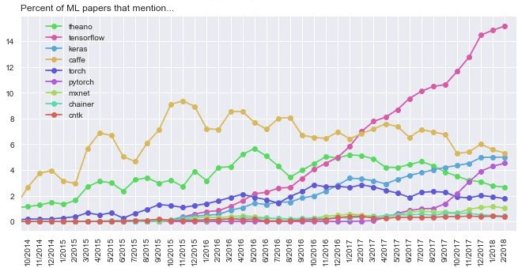
Platforms used for Deep Learning
Deepsense.ai
Tensorflow: Google
PyTorch: Facebook (2017)
Caffe: UC-Berkeley
Theano: Univ. of Montreal
Keras: Library that works with Theano, TensorFlow. Standard Python API for neural networks

Slide 27
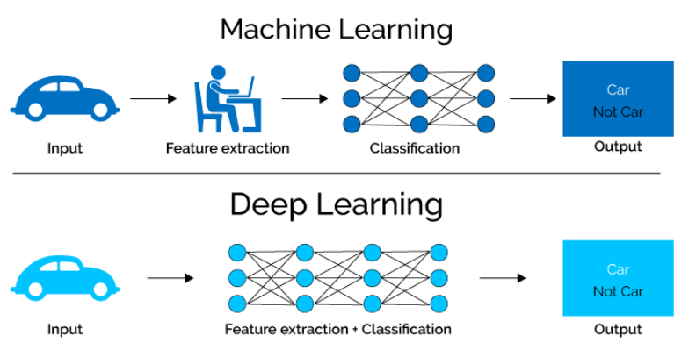

Difference between feature-based ML and deep learning
https://towardsdatascience.com/why-deep-learning-is-needed-over-traditional-machine-learning-1b6a99177063
Property | Feature-based ML | Deep Learning
Input data | Needs to be analyzed carefully prior to ML | Not as extensive pre-processing as ←
Time | For large datasets, lots of time | For large datasets, quick
Interpretability | High | Low
Infrastructure | Regular workstations, HPCs ok | Large datasets require GPUs
Typical use case | Small-ish datasets (not millions of instances), feature extraction | Extremely large datasets, When feature extraction is difficult
Examples | Many areas | Image analysis, natural language processing

Slide 28

BREAK!
of dawn

